Slide 1

A simple JavaScript library for programmers

Slide 2
Introduction
A simple library that you can use to create block templates that can easily be manipulated and add methods or events to a certain element in the document.
This library also helps you to learn a few tricks to create a good user-interface website that can easily be designed using this library.
This library is mostly used to create my projects and will help me to easily integrate JavaScript events to my HTML codes. This library is powered purely by JavaScript but you can combine both HTML and JavaScript integration on a said syntax that I will be showing you on this document so sit back and read!
This library might be familiar to you like famous frameworks out there on the internet like Angular.js by Google, React.js by Facebook, and Vue.js by Evan You. This library is almost similar to these 3 famous frameworks but this one like Vue.js doesn't need any complications on installing or integrating into your projects. It is light and easy to use than these 3 famous frameworks already in the market.

Slide 3
Where Can we download it?
You can download the library here: https://github.com/juztpost/gamm.js

Slide 4
INTEGRATION

Slide 5
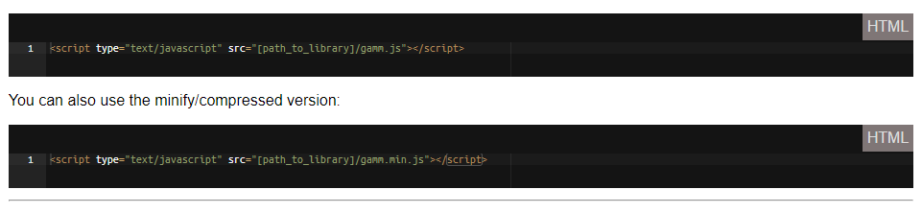
Integration

Slide 6
HTML RENDER

Slide 7
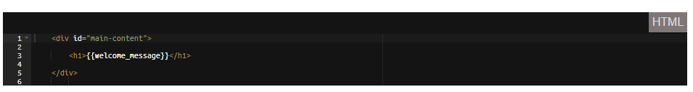
HTML Render
To render or pass variable data like the other frameworks you can use double open and close brackets and inside is the data name or variable name

Slide 8
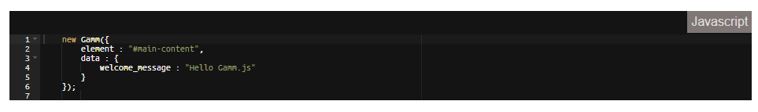
HTML Render
And to use the library you can use the class new "Gamm" with object parameters element on which element you want to parse and compile the results.

Slide 9
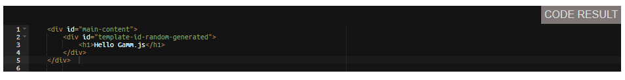
HTML Render
The said code will generate this result in HTML and will insert to the element value on the parameters object "element". But will also include and enclose the inner HTML with "<div>" tag with a random id generated as a template-id for the parse HTML code.

Slide 10
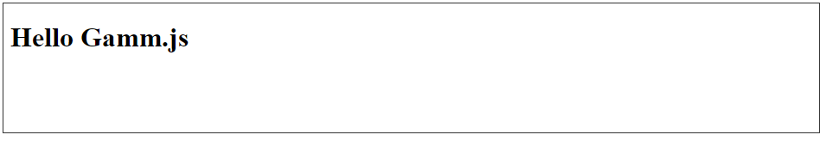
HTML RENDER
Result

Slide 11
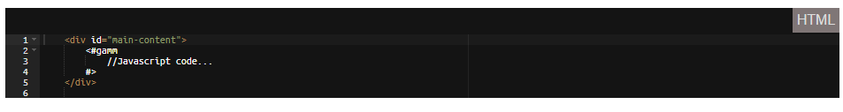
HTML RENDER - The Gamm Tag
The use of gamm tag is usually for loop and conditional syntax. For more examples you can check loops and coditions pages. but below is a little example of usage of it.

Slide 12
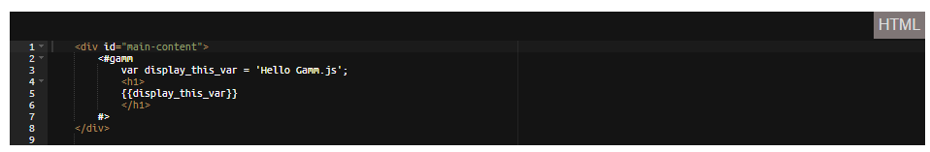

HTML RENDER - The Gamm Tag
A little more sample.
Initialize it

Slide 13

HTML RENDER - The Gamm Tag
Result

Slide 14
Data and models

Slide 15
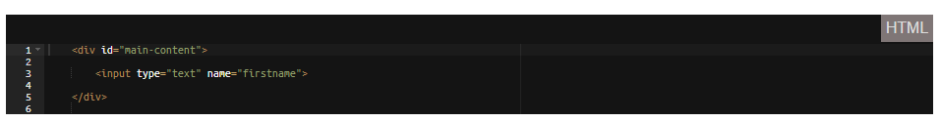
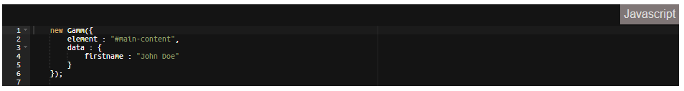
Data AND Models
Data and models in this library can be declared via user input forms by the "name" attribute. No need to use another custom attributes we can just use the already built-in "name" attribute.
Initialize it.

Slide 16
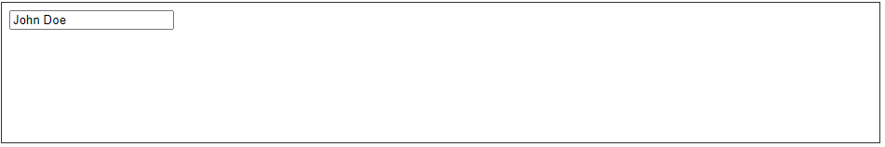
Data AND Models
Result

Slide 17
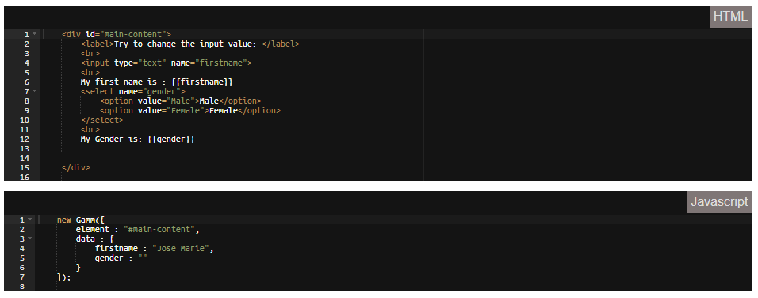
Data AND Models – Data Binding
When you change value of a model or data. It will also change the data which you have put on the brackets and even in the inputs. The forms has a watcher that detects change of value and also changes the values related to that data or model.

Slide 18
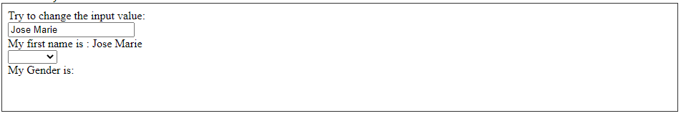
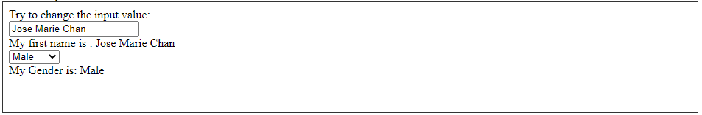
Data AND Models – Data Binding
Result
Change Values

Slide 19
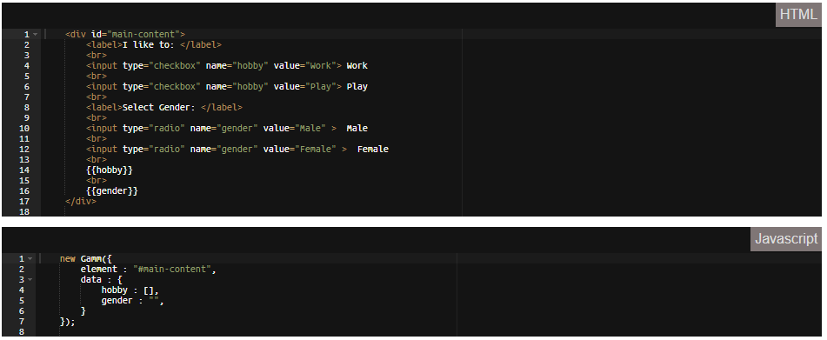
Data AND Models – Data Binding On Radio and check boxes
Checkbox returns the value of the check input, while radio box returns values to an array of data of checked radio boxes.

Slide 20
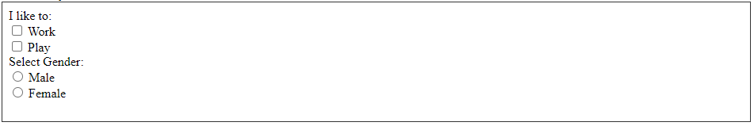
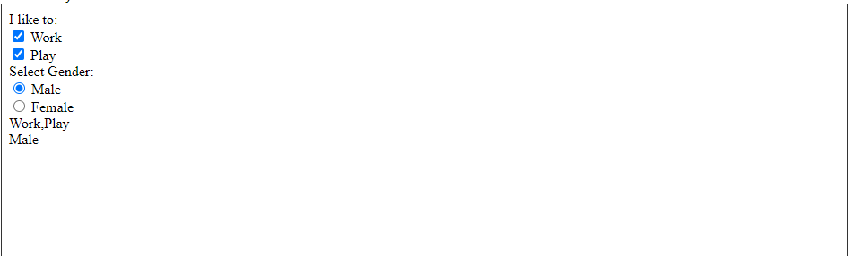
Data AND Models – Data Binding On Radio and check boxes
Result
Final Result

Slide 21
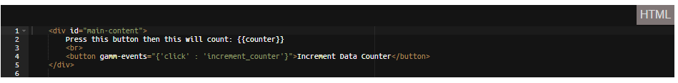
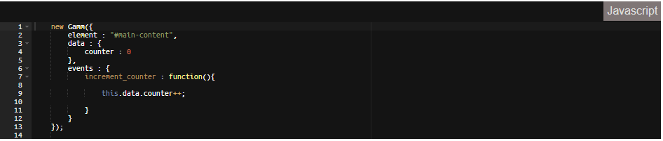
Data AND Models – Data Updates after an event is fired/triggered
When a data is manipulated inside the function in events parameters it will also update the template object base on the code execution or syntax you composed.

Slide 22

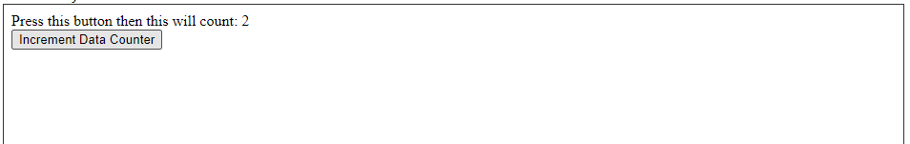
Data AND Models – Data Updates after an event is fired/triggered
Result
When Button Is Clicked:
Click Again:

Slide 23
EVENTS OR METHODS

Slide 24
EVENTS OR METHODS
Adding events to the element is easier just by adding an attribute "gamm-events" with a JSON data starts with the key as the name of the event and value as the function inside "events" parameters in the library class.
As the element has an attribute "gamm-events" will be compiled to attribute base on the event you added. For example a "click" event will converted to "data-gamm_click" with a value of the template_id and "_" with the number base on the number of the element compiled start to zero(0).

Slide 25
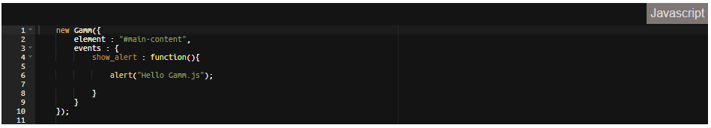
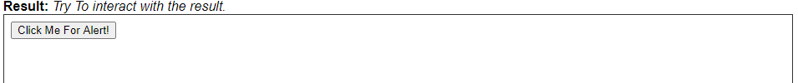
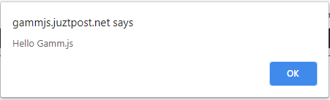
EVENTS OR METHODS
Here you can see we add a JSON format data inside "gamm-events“ attribute with the key as "click" and the value is the function name "show_alert".
Result

Slide 26
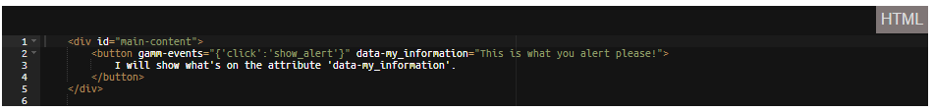
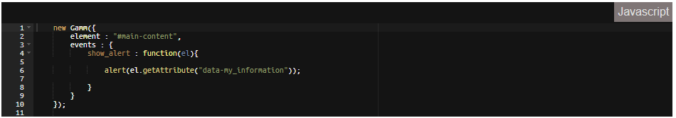
EVENTS OR METHODS - GET ELEMENT DATA OR PROPERTIES ON EVENTS
To get the element properties of the attached event you will need to add a first parameter to your function. Through this you will able to see all the information you needed.

Slide 27
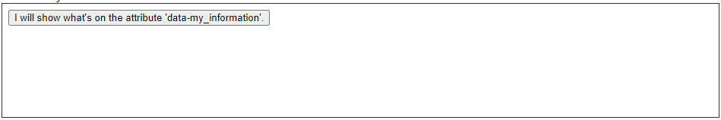
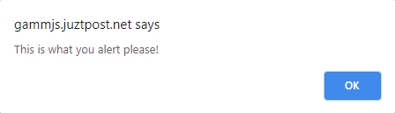
EVENTS OR METHODS - GET ELEMENT DATA OR PROPERTIES ON EVENTS
Result

Slide 28
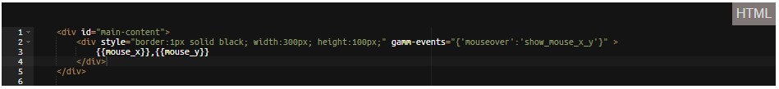
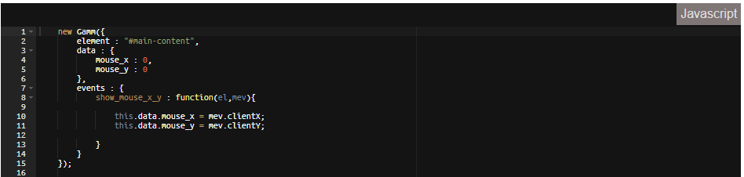
EVENTS OR METHODS - GET ELEMENT MOUSE EVENT
This time to get the mouse events of a element that you have attached a method/event you just need to add a second parameter to your function. See example.

Slide 29
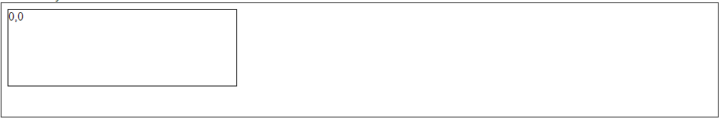
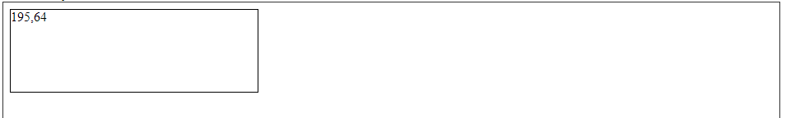

EVENTS OR METHODS - GET ELEMENT MOUSE EVENT
Result
When I enter my mouse.

Slide 30
LoopS

Slide 31
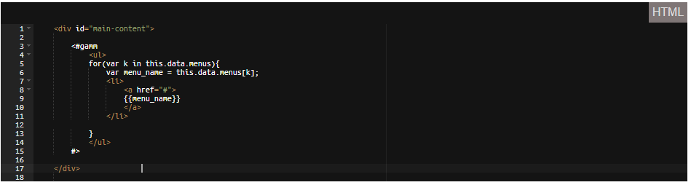
LOOPS
This is a common thing in data handling when you want to display same html format and the only changing is the value of a given lists. For the loop to work we don't need to add any attribute but use what JavaScript already offers.

Slide 32
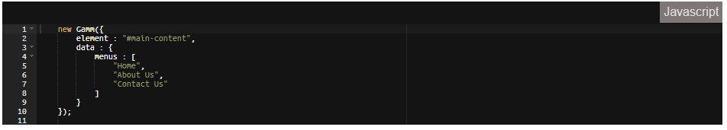
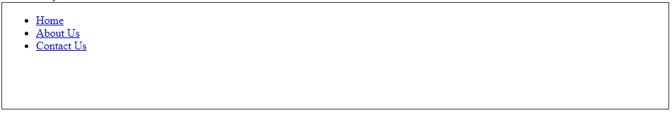
LOOPS
Initialize It
Result

Slide 33
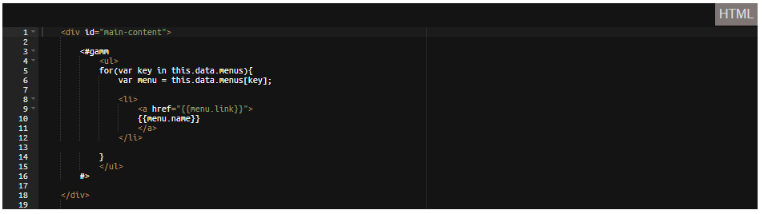
LOOPS - Object Loop
Like the above loop we can also use "For" Loop method already in JavaScript.

Slide 34
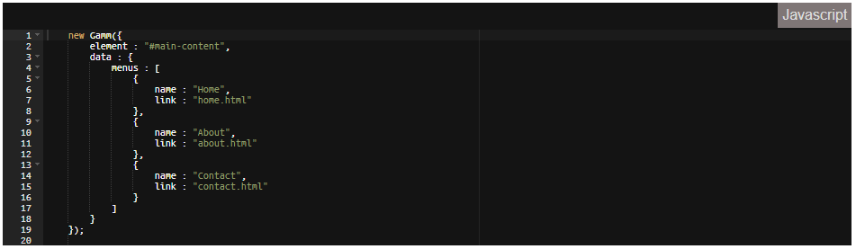
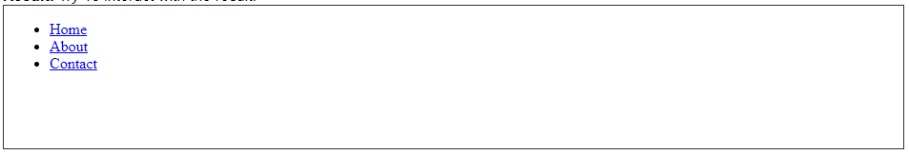
LOOPS - Object Loop
Initialize it.
Result

Slide 35
CONDITIONS

Slide 36
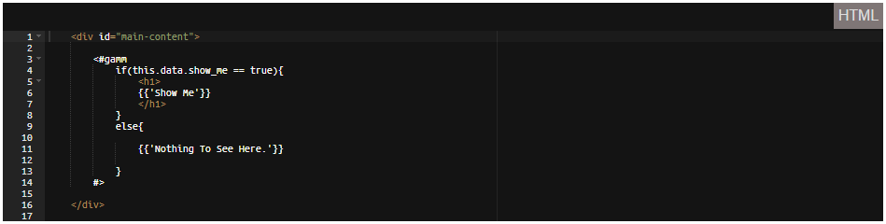
CONDITIONS
Condition is very important for us developers to limit something we want to display, execution, time, etc... So in this page I will show that it is easy to use those conditions because this library is already using JavaScript syntax. See example.

Slide 37
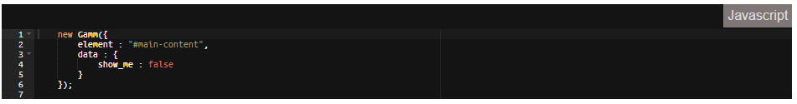
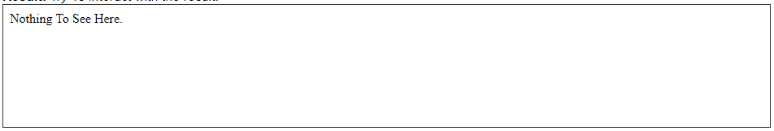
CONDITIONS
Initialize it.
Result

Slide 38
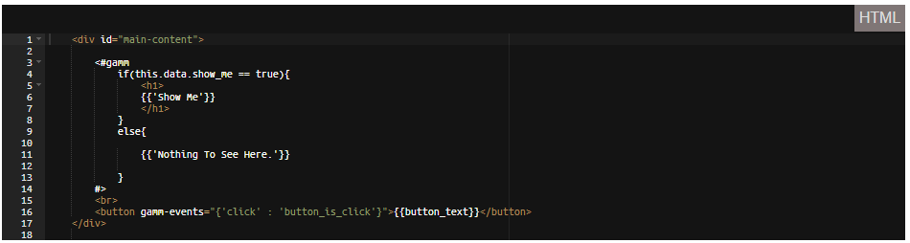
CONDITIONS - Play with events and conditions
See Example

Slide 39
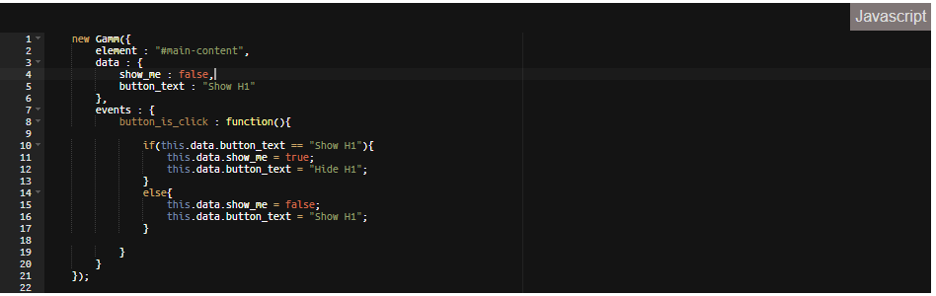
CONDITIONS - Play with events and conditions
Initialize it.

Slide 40
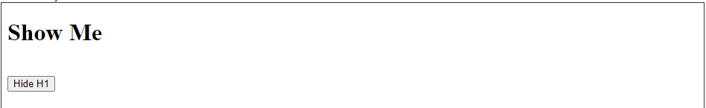
CONDITIONS - Play with events and conditions
Result
Button is clicked.

Slide 41
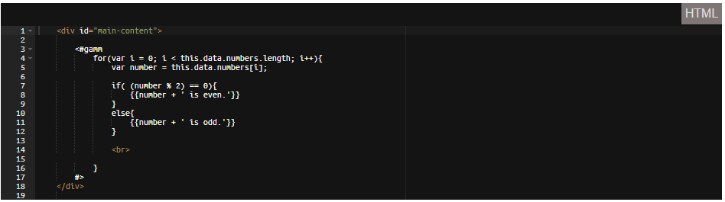
CONDITIONS - Arithmetic condition
Arithmetic condition is also very important so we can identify values that needed to be process or execute a given code. See Example.

Slide 42
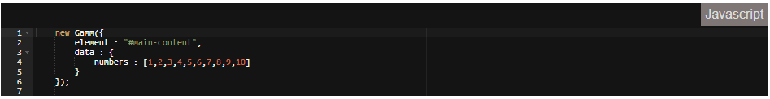
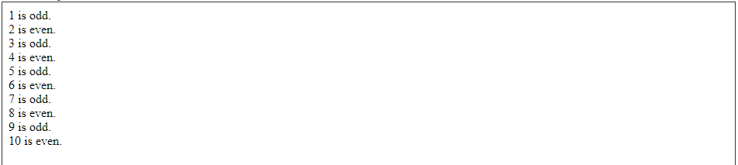
CONDITIONS - Arithmetic condition
Initialize it.
Result

Slide 43
STYLING

Slide 44
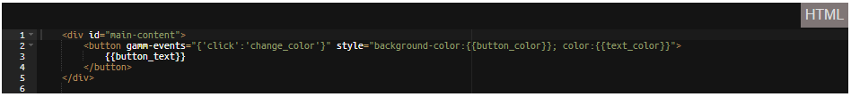
Styling
Styling in this library is not far from we already have in JavaScript, we can use style tag, CSS or even the style attribute and put values on it. As the library is flexible, we can directly associate object/variables/data into the attributes itself. See Example.

Slide 45
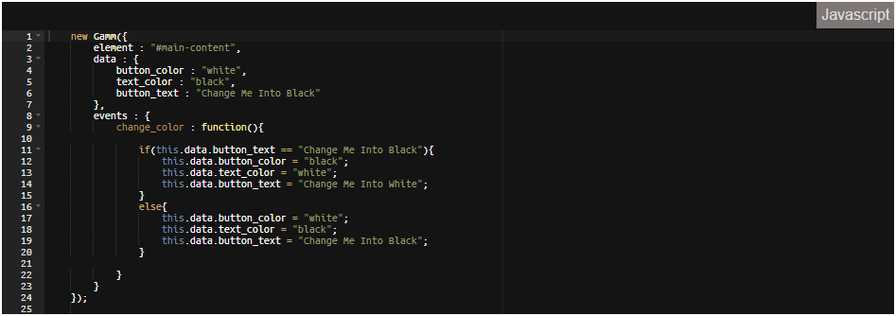
Styling
Initialize it.

Slide 46
Styling
Result
Button clicked

Slide 47
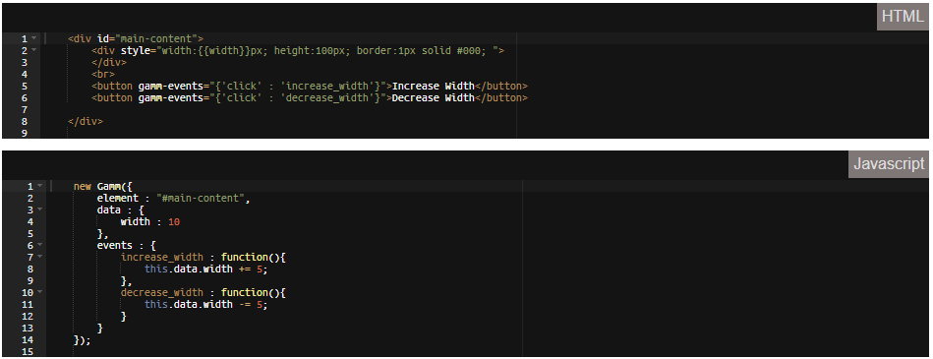
Styling – styling techniques
As the library always says, we can already use JavaScript functions that is built-in, this is what makes this library easy to use because we already have JavaScript documentations and to make everything faster.

Slide 48
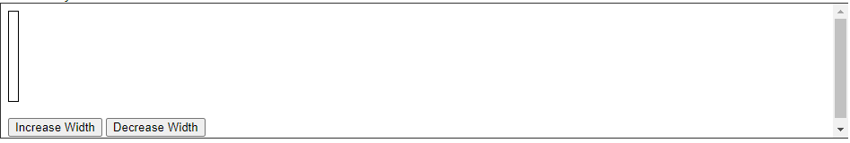
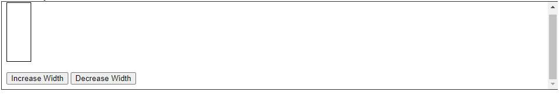
Styling – styling techniques
Result
Button “Increase Width” clicked 6 times

Slide 49

Styling – styling techniques
Button “Decrease Width” clicked 3 times

Slide 50
Templates

Slide 51

Templates
This library also offers to call a file to easily make your own templates if you want a separate a certain are of your project. You can make blocks or modular template so you can easily fix which part may cause the problem or issue.

Slide 52

Templates

Slide 53

Templates
Use of built-in Gamm method "other" To pass data values to other Gamm classes. Read more on Gamm methods.

Slide 54


Templates
Result
Filling up the inputs

Slide 55

Templates
“Submit” button clicked

Slide 56
GAMM METHODS

Slide 57

GAMM methods
This methods is what we have to offer so far. But in the long run we may have to add more features to make the library more flexible and useful. This method is attached or bind into the class itself.

Slide 58

GAMM methods

Slide 59

GAMM methods

Slide 60

GAMM methods
-Below functions only works inside the Gamm Template Content.

Slide 61

GAMM methods

Slide 62
Limitations

Slide 63
Limitations
As all library or framework all has limitations and flaws. This flaws may be fixed along the way or it will be the limit and we make alternatives to make remove this limitations.

Slide 64

Limitations – Table tags
table tag is having issue on this library because when you create table and put a Gamm Syntax inside the browsers auto separate the contents inside the table that is not necessary for its content. So to fix this solution we have the method "tag", "$", and "$$". This is by if you really want to use table inside the Gamm Templates.

Slide 65

Limitations – Table tags
Resulting into

Slide 66

Limitations – Table tags
Live result in the inspect source code html element (google chrome)

Slide 67

Limitations – Table tags
Solution so far

Slide 68

Limitations – Table tags
Result

Slide 69

Limitations – Double quotations
This one is a very strict compliance for the Gamm Template. Double quotes cause errors because Gamm Compiler compiles everything as string. So the solution to this is only using single quote when display a string or using it on conditions. See Example.
Result

Slide 70

Limitations – Double quotations
-Result

Slide 71

Limitations – Double quotations
More Example
Result

Slide 72

Limitations – Double quotations
Solution so far.
Always start with a single quote(') and end with another single quote(') to display strings. Or (`) grave accent key.
Result

Slide 73

Limitations – Always use single quote on gamm tag or grave accent
If you want to put string or text inside Gamm Tag always use {{''}} this symbols. It will cause a major error in compilation if you directly put text in the Gamm Tag.
Result

Slide 74

Limitations – Always use single quote on gamm tag or grave accent
Correction
Result

Slide 75
Limitations – Gamm tag limitations on html tags
Gamm Tag limits is mostly html tags. HTML tags won't work unless they are separated by line. Every code is good to look at if properly separated by line, So this library may practice you to do so.
Resulting to
gamm_echo is a method inside Gamm Tag that use in compilation. So if the html tags is not properly separated by new line this error/issue will occur.

Slide 76

Limitations – Gamm tag limitations on html tags
Solution

Slide 77

Limitations – Gamm tag limitations on html tags
Result

